Slide 1
Processing of car accidents data with Spark
Saúl Almazán del Pie
Marina Alonso-Cortés Lledó
Jorge Santisteban Rivas

Slide 2
Purpose
Infer qualitative data regarding the car accidentes in New York City such as:
Number of lethal accidents per week
Number of accidents and percentage of number of deaths per contributing factor
Number of accidents and avarage number of lethal accidents per week per borough

Slide 3
Apache Spark
Spark is a Framework to make computations with large amount of data. Spark gives you two features to handle cases like this:
Parallel Computing
Fault Tolerance

Slide 4
Spark Clusters
A Spark cluster is just some computers running Spark and working together. A cluster consist on:
Master: is one of the computers that orchestrate how everything works. It distributes the work and take care of everything.
Slaves: these are the computers that get the job done. They process chunks of your massive datasets following the Map Reduce paradigm. A computer can be master and slave at the same time
Standalone
It just mean that Spark is installed in every computer involved in the cluster. The cluster manager in use is provided by Spark.

Slide 5
Set up the problem
Spark needs Java to run.
Install Spark
Launch the master Server and the workers
Run the Jupyter notebook scrypt

Slide 6
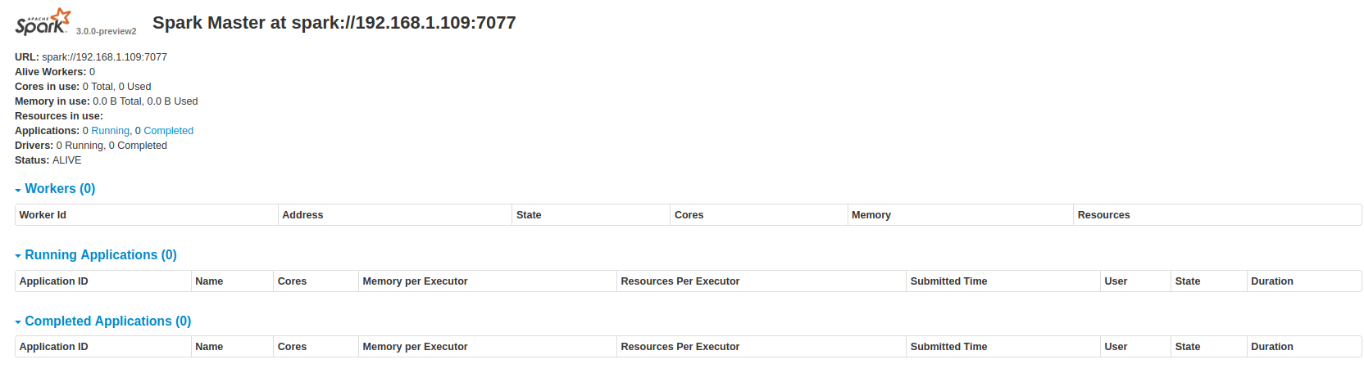
Master Server
Accepts jobs from driver programs, and schedules processing tasks on available slaves. To start it, once Spark has been installed, we should run:
./sbin/start-master.sh -h <your_master_ip_>
Once we have run it, we will go to localhost:8080 and we will see something like this:

Slide 7
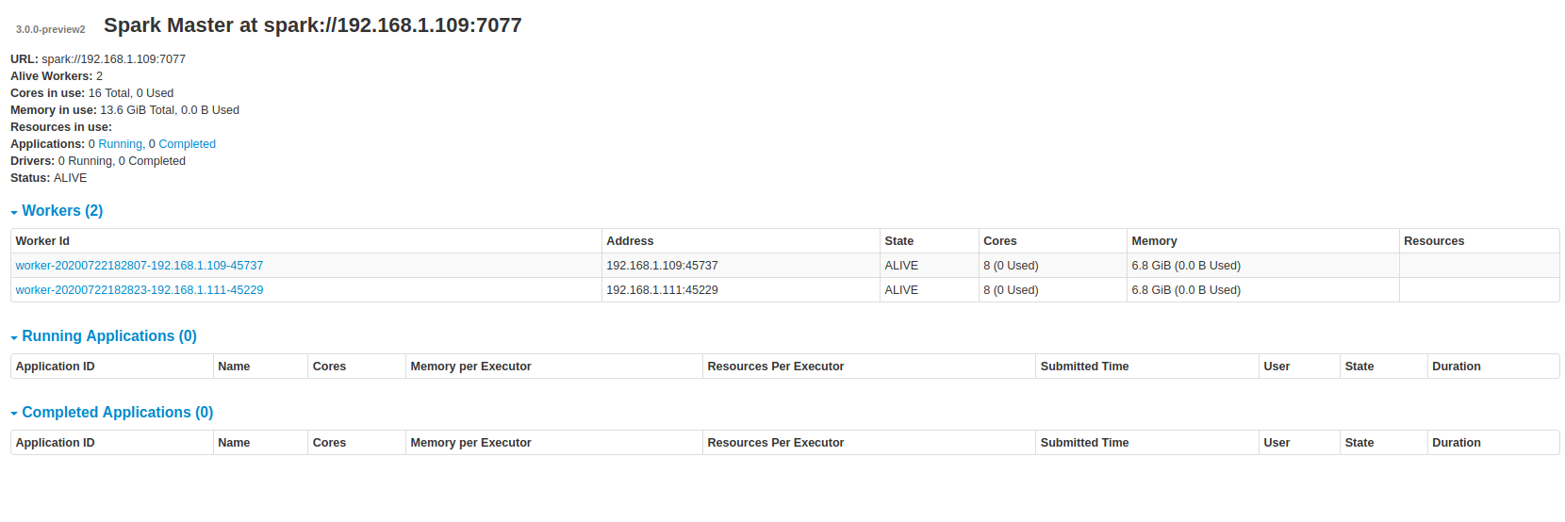
Slaves
To start a slave server you have to type the following command running from your Spark installation folder, using the URL you copied from the master server web interface:
./sbin/start-slave.sh <your_master_url>
We can run this script in the master or in other slave machines. In our first try we will add 2 slaves. Once we have done we will see something like this:

Slide 8
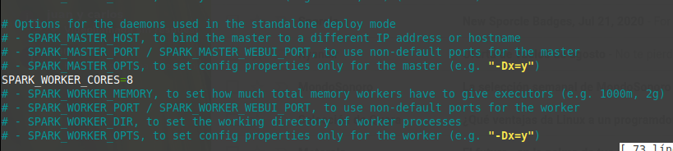
Configure Spark environment
We will be able to configure our Spark environment by modifying the following script:
/conf/spark-env.sh
We will be able to modify several fields, such as:

Slide 9
Our setup
For this problem we will work with:
An Apache Spark standolone server
2 Linux Mint Machines
A CSV file from where we will get all the information
A Jupyter notebook scrypt to run the necessary queries
How will join Spark and Jupyter? -> PySpark!

Slide 10
PySpark
Findspark is a Python library that automatically allow you to import and use PySpark as any other Python library. There are other options to make the integration (create a Jupyter profile for Spark) but up to date Findspark is the faster and simpler one.
To create the Spark app run the following script in a Jupyter cell:
import findspark
findspark.init()
import pyspark
sc = SparkSession.builder.master("spark://192.168.1.38:7077").appName("NYC Traffic").getOrCreate()

Slide 11
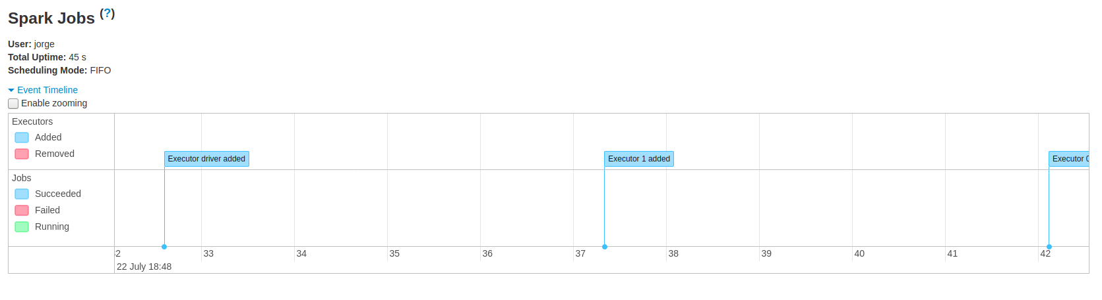
PySpark
In that session we will find something like this:

Slide 12
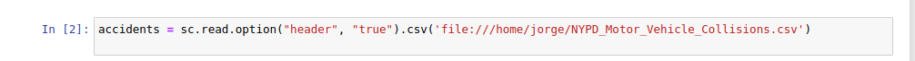
Loadind the dataset and queries
Before all the queries we will need to load the CSV file containing all the information. To do so we will run:
What about the queries? As we have defined an Spark session we can use the included function sql to do all the necessary queries we want to run.

Slide 13
Query1: Number of lethal accidents per week
First we format the Date
accidents.withColumn("DATE", to_timestamp(col("DATE"), "MM/dd/yyyy"))
Second , using the function date_format(col("DATE"), "w")) we create a column with the number of the week and we add it to the database
Finally we make the query where number of people killed is not null , grouping by year and by the new column we created before and ordering by year and the new column.

Slide 14
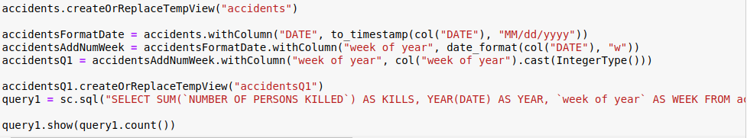

Slide 15
Query2: Number of accidents and percentage of number of deaths per contributing factor
We are going to separete the query in smaller queries
First we exctract the posible factors
(SELECT `CONTRIBUTING FACTOR VEHICLE 1` as FACTOR FROM accidentsQ2 WHERE (`CONTRIBUTING FACTOR VEHICLE 1` IS NOT NULL) AND (`CONTRIBUTING FACTOR VEHICLE 1` != 'Unspecified'))"
We will do this with the 5 possible factors and then we'll unite the five queries into one.

Slide 16
Query 2
Then we extract the number of killed people per each factor
SELECT factorsTable.FACTOR, accidentsQ2.`NUMBER OF PERSONS KILLED` FROM factorsTable JOIN accidentsQ2 ON factorsTable.FACTOR=accidentsQ2.`CONTRIBUTING FACTOR VEHICLE 1`
and this again with the 5 diferents contributing factor
Now we just have to make the final query to obtein the %
SELECT FACTOR, COUNT(*) as ACCIDENTS, ROUND(AVG(`NUMBER OF PERSONS KILLED`)*100, 5) AS PERCENTAGE FROM queryDef GROUP BY FACTOR ORDER BY ACCIDENTS

Slide 17
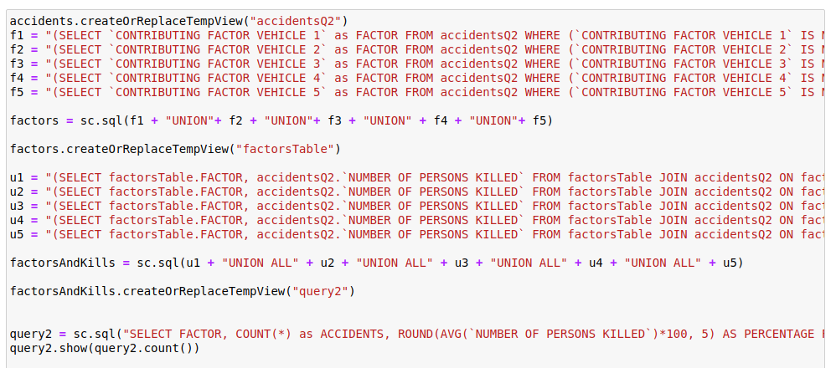

Slide 18
Query3: Number of accidents and avarage number of lethal accidents per week per borough
In this query we are going to use the same querys used before in query 1 but first we are going to select the boroughs to make it easier
SELECT DISTINCT BOROUGH from accidentsQ3 WHERE BOROUGH!='0' ORDER BY BOROUGH
Once we got the boroughs we will do the same query for each of them:
Example for Bronx
SELECT YEAR(DATE) AS YEAR, `week of year` AS WEEK, COUNT(*) AS ACCIDENTS, ROUND(AVG(`NUMBER OF PERSONS KILLED`)*100,5) AS `% KILLS` FROM accidentsQ3 WHERE (`NUMBER OF PERSONS KILLED` IS NOT NULL) AND (BOROUGH = 'BRONX') GROUP BY YEAR(DATE),`week of year` ORDER BY YEAR(DATE),`week of year`
Grouping by year and ordering by year and the number of weeks

Slide 19
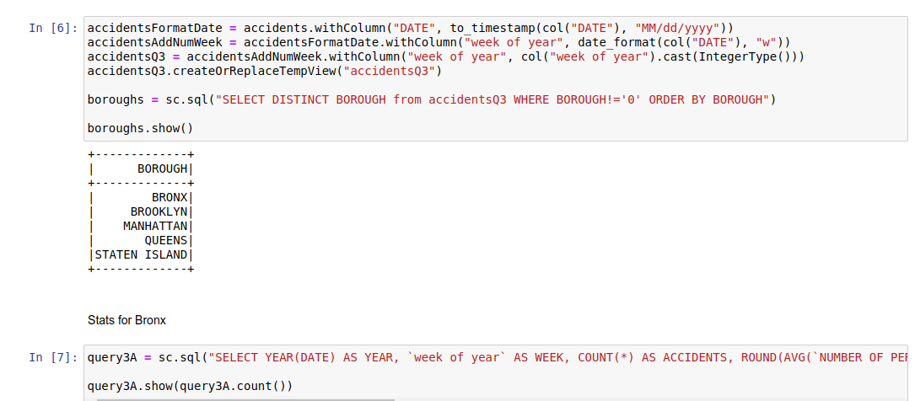

Slide 20
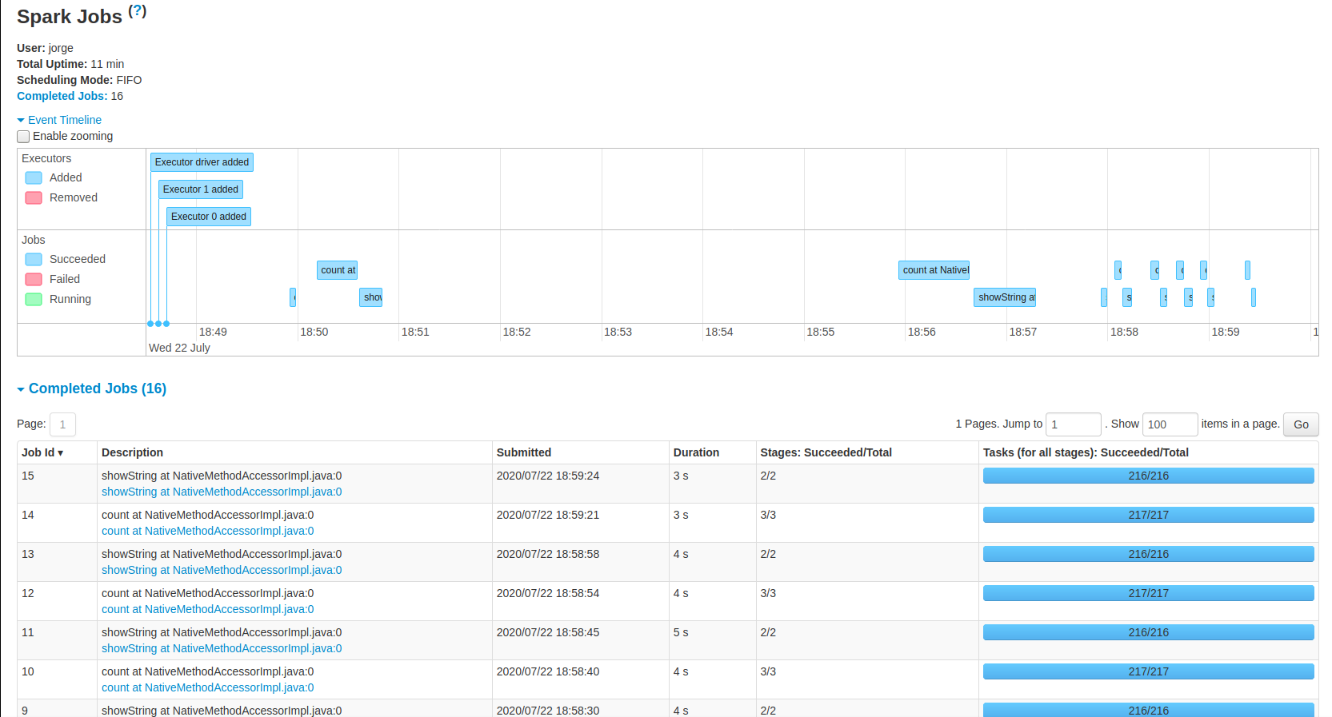
After the queries
After the queries our server will look like this:
We will be able to see all results in ResultsNYC.pdf

Slide 21
Conclusion
In order to analyse the performance we have modify 2 fields:
Number of workers (adding more machines)
Number of cores used by each worker
Results? We have obtained confused conclusions.
In theory by adding more slaves to the server the time should decrease time, but in some cases it didn't!
This may be because we upload the csv file to the master and it needs to distribute it to the other computers , so the time to transfer the data over the network and recover the result back may eat up the time savings obtained when distributing the problem to more workers.

